Slide 1
5383 - Assignment One
Sequential Football Game
By Andrew Huff

Slide 2
Agenda
Company Name
Date
1. Program Design
2. Class Interactions
3. Game Demonstration

Slide 3
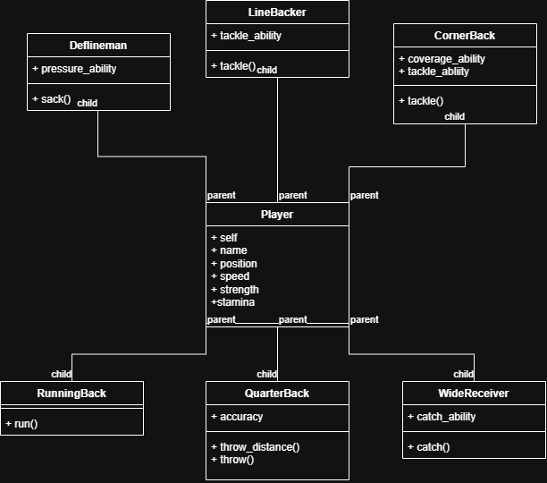
Program Design - Players
Sequential Football Game

Slide 4
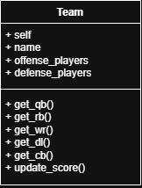
Program Design - Team Info
Sequential Football Game

Slide 5
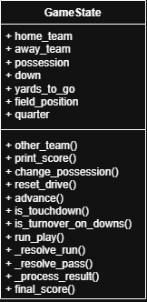
Program Design - Game Info
Sequential Football Game

Slide 6
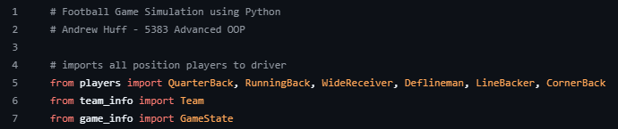
Class Interactions
Sequential Football Game
Primary interactions
Players (super class) to Quarterback, Running back, etc.
Imported all classes to driver.py

Slide 7
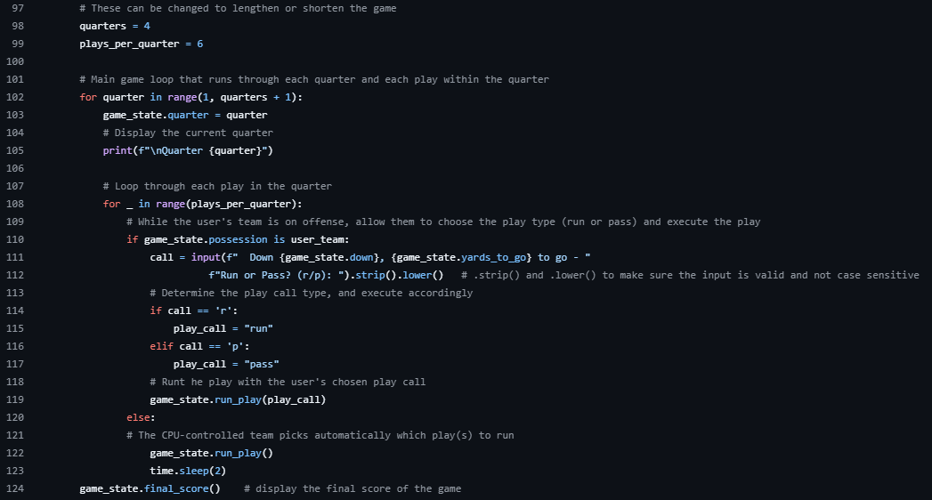
Class Interactions Cont.
Sequential Football Game
3. Main game loop

Slide 8
Program Demonstration
Sequential Football Game
https://github.com/AndrewHuff6/5383_Advanced_OOP/tree/main/Assignments/A1

Slide 9

Questions?

Slide 10
Resources
In-class lectures and code
Claude (_resolve_run() & _resolve_pass() in game_info.py)

